Slide 1
Digital Portfolio
STUDENT NAME: S.HARIYA NATCHIYAR
REGISTER NU AND NMID: 2422K1156 AND 6D8BD68C88AC5B08F0A41A434F179D7C
DEPARTMENT: B.SC (COMPUTER SCIENCE)
COLLEGE: GOVERNMENT ARTS AND SCIENCE COLLEGE ( CO-ED ), AVINASHI, BHARATHIYAR UNIVERSITY

Slide 2
PROJECT TITLE
DIGITAL PORTFOLIO

Slide 3
AGENDA
1.Problem Statement
2.Project Overview
3.End Users
4.Tools and Technologies
5.Portfolio Design and Layout
6.Features and Functionality
7.Results and Screenshot
8.Conclusion
9.Github Link

Slide 4
Problem Statement
1. In the current digital era, students and professionals need an effective way to present their skills, projects, and achievements.
2. Traditional resumes are static and do not showcase technical skills interactively.
3. To solve this, a digital portfolio website is developed using HTML, CSS, and JavaScript.
4. This portfolio provides a responsive and user-friendly platform where personal details, skills, and projects can be displayed professionally.
5. It also allows easy accessibility through hosting on GitHub Pages.

Slide 5
2.Project Overview
1. The project “Digital Portfolio Website” is a personal website developed using HTML, CSS, and JavaScript.
2. It is designed to showcase my personal details, educational background, skills, and projects in a professional manner.
3. The website has multiple sections such as About, Projects, and Contact, and it uses responsive design to work on both mobile and desktop screens.
4. The portfolio is hosted on GitHub Pages, making it easily accessible to anyone through a public link.

Slide 6
3. End Users
The end users of this project are:
Recruiters & Employers → To view my skills, projects, and achievements during placements or job opportunities.
College Faculty & Evaluators → To assess my project work and technical skills.
General Audience → Anyone who wants to know about my profile, education, and work.

Slide 7
4. Tools and Technologies
HTML5 → Used to create the structure of the portfolio (sections, headings, content).
CSS3 → Provides styling, layout design, colors, fonts, and responsive effects.
JavaScript → Adds interactivity, dynamic behavior, and smooth user experience.
Code Editor (CodePen) → Used for writing and editing the source code.
GitHub → For version control and code hosting.
GitHub Pages → Used to deploy and host the portfolio online.

Slide 8
5. Portfolio Design and Layout
Header Section → Contains name/logo and navigation menu.
About Section → Displays profile picture, short bio, and career goals.
Contact Section → Provides email and social media links for communication.
👉 Design Features:
Responsive layout with flexible grids and media queries.
Simple color theme with readable fonts.
Easy navigation using a sticky or top menu bar.

Slide 9
6. Features and Functionality
Responsive across devices
User-friendly navigation
Profile & About info
Projects display
Contact details & links
Clean, professional UI
GitHub Pages hosting

Slide 10
7. Results and Screenshots
A Digital Portfolio Website was successfully designed and developed.
The site is responsive, adapting to desktop, tablet, and mobile screens.
Contains structured sections: Home, About, Contact.
The portfolio is hosted on GitHub Pages and accessible anytime, anywhere.
Provides a professional platform to showcase personal skills and projects.

Slide 11
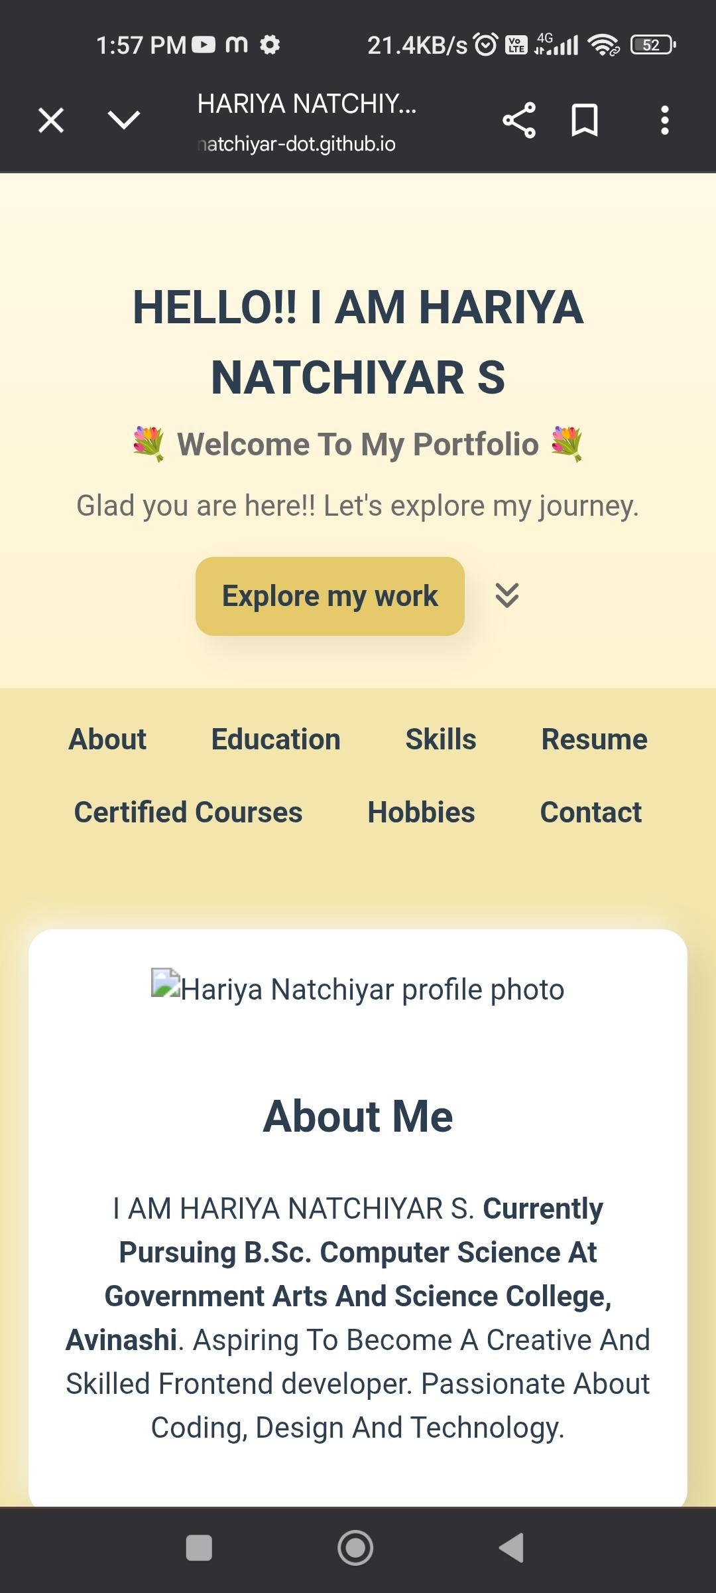
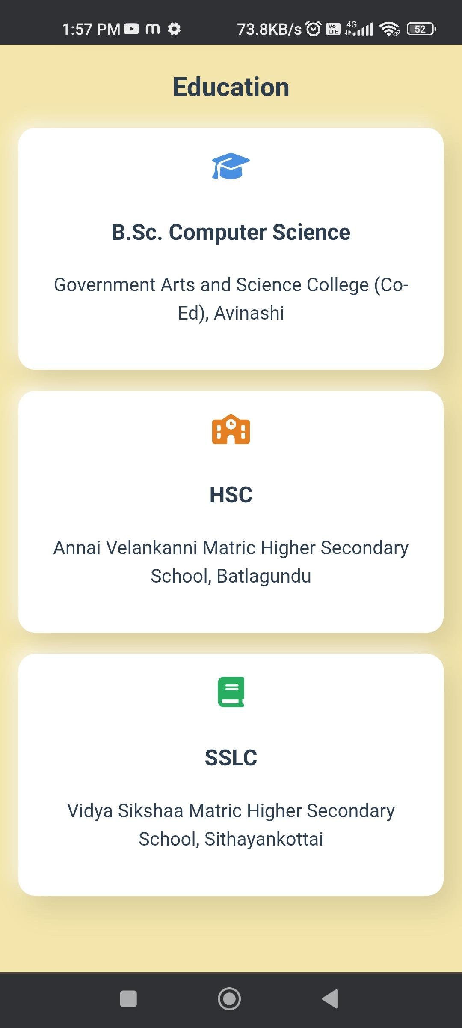

Slide 12
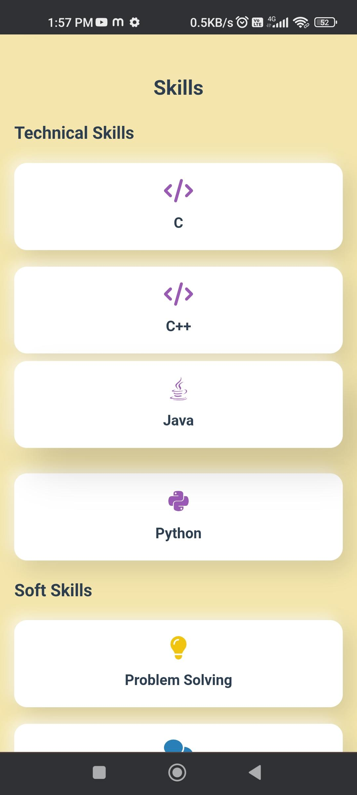
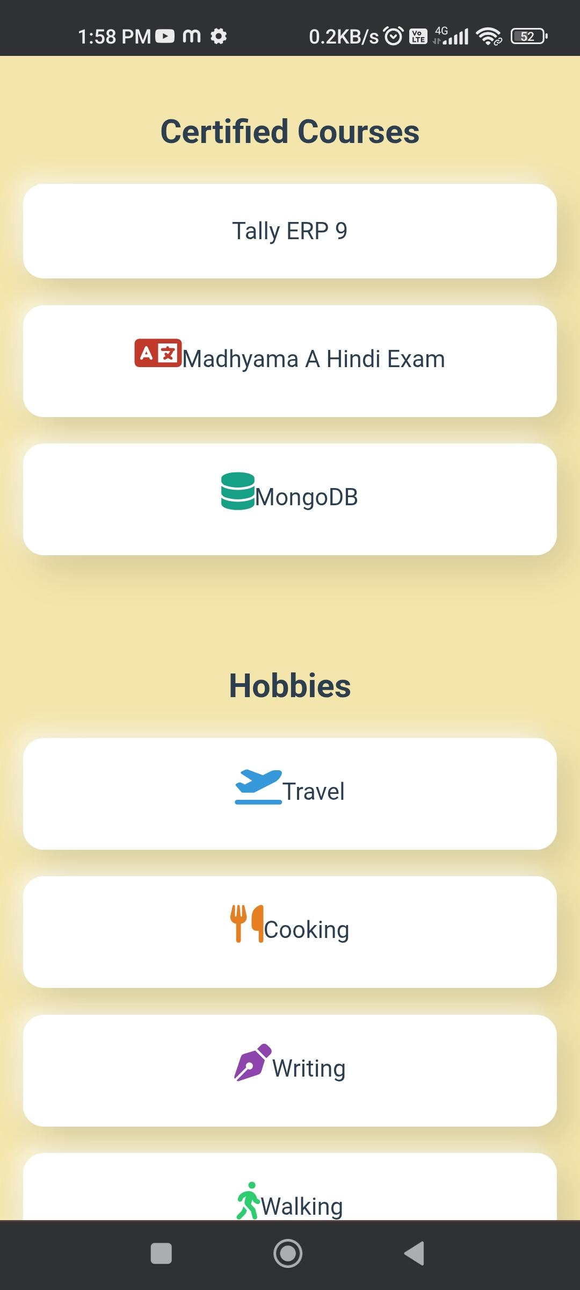

Slide 13
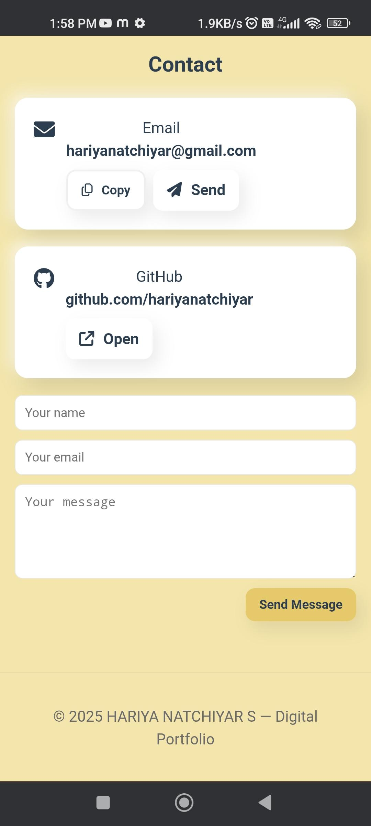
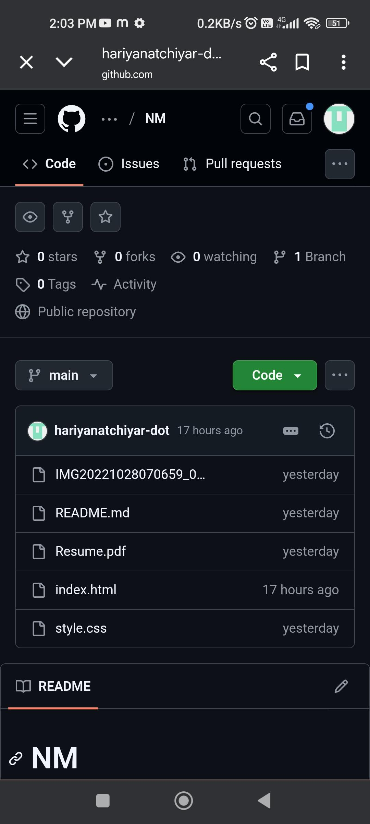

Slide 14
8. Conclusion
Portfolio developed using HTML, CSS, JS
Showcases profile, skills, and projects
Responsive and user-friendly design
Hosted on GitHub Pages
Professional online identity

